Slide 1

Life Expectancy and GDP Data
Visualize Data with Python
Petru Apachitei
Date: 01-10-2020

Slide 2
Example Table of Contents
Introduction to the data research
Life expectancy distribution by country
GDP as a function of Life expectancy by country
Mapping Life Expectancy by country
Mapping GDP by country
Insights

Slide 3
1. Introduction

Slide 4
1.1 Project introduction
In this project, I will analyze data on GDP and life expectancy from the World Health organization and the World Bank to try and identify the relationship between the GDP and life expectancy of six countries.
What is Word Bank?
Word Bank is global organization with members from 189 countries, the world bank group scope is to find sustainable solution that reduce poverty and build prosperity for developing countries.
What is GDP?
GDP sum up the prices of all finished goods and service produced within a country in a year. It is a good indication of how much an economy produces every year.
What is World Health Organization?
WHO is a global organization spread out in 150 countries, their area of work is health system. Its primary activities is to engage partnerships with other global health initiatives, conducting research, setting norms and providing technical support. Today, WHO monitors and coordinates activities concerning many health-related issues, including modified foods, climate change, tobacco, drug use and road safety.
What is Life Expectancy at birth?
Life expectancy at birth is defined as how long, on average, a newborn can expect to live. Gains in life expectancy at birth can be attributed to a number of factors, including rise living standards, improved lifestyle, and better education, as well greater access to quality health services.
Life expectancy at birth reflects the overall mortality level of a population. It summarizes the mortality pattern that prevails across all age groups in a given year – children and adolescents, adults and the elderly.

Slide 5
1.2 Examine the data
Dataset for this project:
The GDP data comes from
The data consist of 5 columns:
Column ‘Country’ contain the name of the countries selected for this project: Chile, Mexico, China, USA, Germany and Zimbabwe
Column ‘Year’ contain years between 2000 and 2015.
Column ‘LEABY’ are average life expectance at birth for each country from dataset between 2000 and 2015.
Column ‘GDP’ is the gross domain product for each country from dataset between 2000 and 2015.

Slide 6
2. Data Visualization

Slide 7
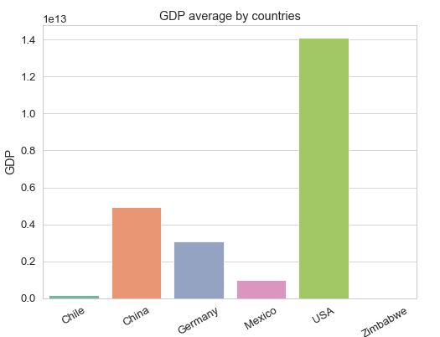
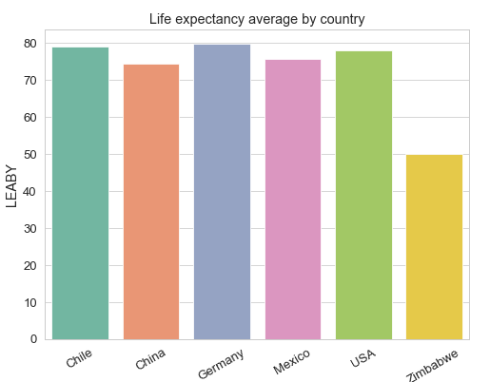
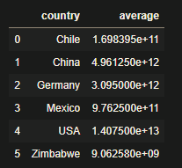
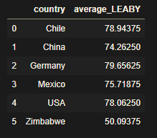
2.1 Compare average GDP and life expectance by countries
Create a bar chart to compare average GDP income versus Life Expectance indices for each country from dataset.
Conclusion:
The highest GDP is hold it by USA and lowest by Zimbabwe which do not appear in bar chart due to the discrepancy in GDP income between tops countries.
For the life expectancy, the first country is Germany with average age of 80, followed to small differences by next four countries the lowest life expectancy is indicated by Zimbabwe with 50 years.
Country
Country

Slide 8
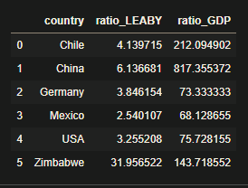
2.2 What do you notice about the two bar charts? Do they look similar?
Compare the two plots for each country, calculate the rate between 2000 and 2015 for every country.
To calculate the percentage increase:
% Increase = New number – Original number / Original number x 100
Conclusion:
Significant change in GDP is noticed for China the GDP increased 8 times in 15 years.

Slide 9
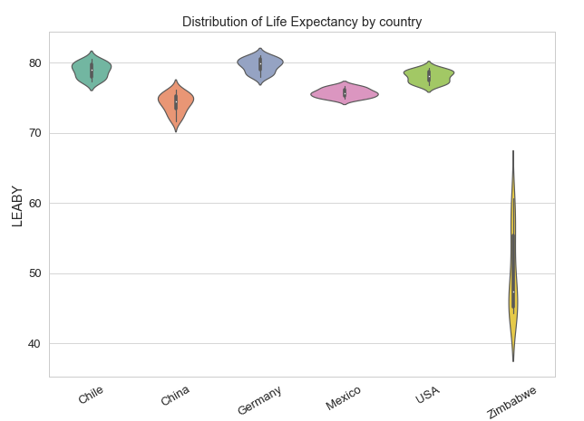
2.3 Life expectancy distribution by country
We want to get an understanding of the distribution for Life Expectance by each country.
Questions:
What do you notice about this distribution? Which country's life expectancy has changed the most?
By looking at the shape, Zimbabwe indicates a wide ranges of change in life expectancy.
In comparison with Zimbabwe rest of the countries have homogeneous values between year 2000 and 2015.
Country

Slide 10
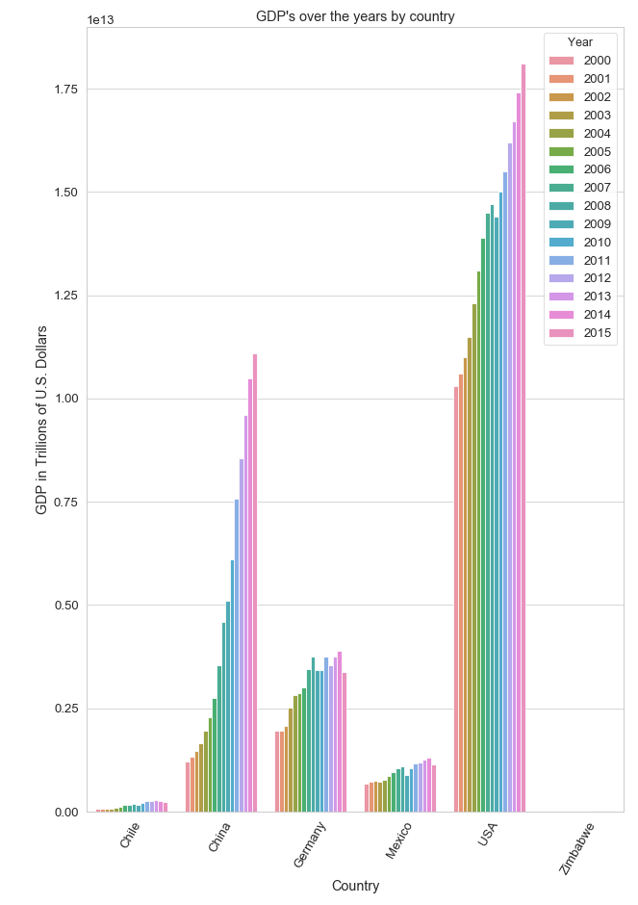
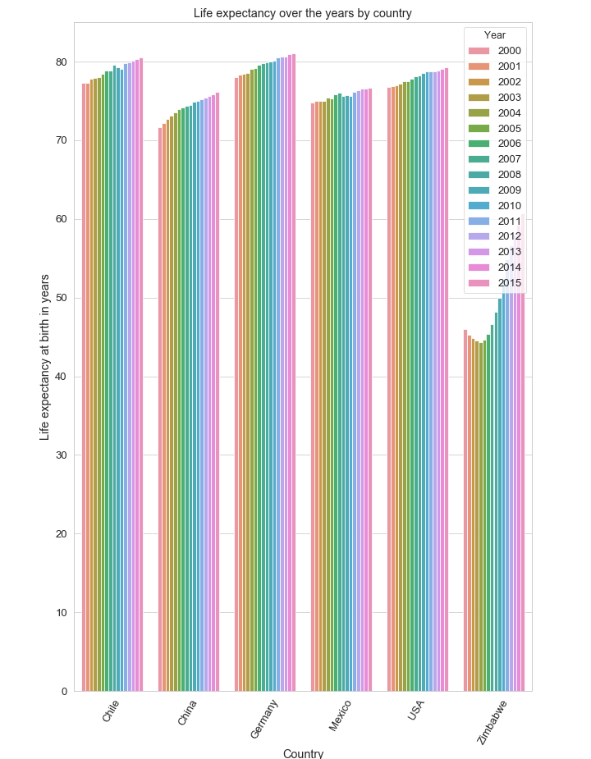
2.3 GDP and Life expectancy over time

Slide 11
2.3.1 Questions
What are your first impressions looking at the visualized data?
Which countries' bars changes the most?
For the last 10 years Germany GDP's has up and downs, life expectancy the biggest change is noticed by Zimbabwe, China has an impressive GDP growth during, significant for last 10 years.
What years are there the biggest changes in the data?
For life expectancy there is a constant increase year by year for Zimbabwe who faces a decline from 2000 to 2005.
GDP China has a constant increase from 2005 to 2015.
During 2009 GDP for most of the counties are affected by the global financial crisis, except China and Zimbabwe which continue to grow .
Which country has had the least change in GDP over time?
The least change in GDP is noticed by Mexico with a grow rate of 68 over the years from 2010 to 2015, followed by Germany with 73% and USA with 75%.
How do countries compare to one another?
GDP 2000 to 2015:
USA has the biggest GDP income, China has the highest growth rate in GDP by 813% followed by Chile with 211%, Zimbabwe shows the low GDP income from this group of countries.
Leaby 2000 to 2015:
Germany has the highest average life expectancy at 80 years, Zimbabwe shows a significant growth in life expectancy 31% but still remains the country with lowest average LEABY.
Now that you can see the both bar charts, what do you think about the relationship between GDP and life expectancy?
Compare One by one chart for each country, relationship between GDP and life expectancy depends out of the country, for example Zimbabwe both plots have same shape, conclude that there is a relationship between GDP and life expectance, on the other hand developed country like Germany life expectancy has a constant increase separate from GDP income per year.
Can you think of any reasons that the data looks like this for particular countries?
Good comparation would be GDP per capital in relation with life expectance.

Slide 12
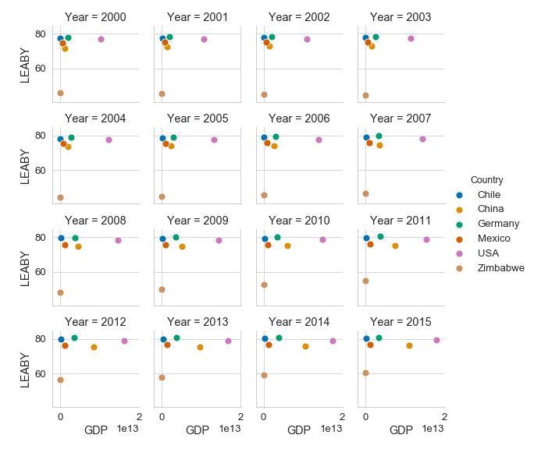
2.4 GDP as a function of Life expectancy by country.
We will chart the life expectancy in relation to the GDP over the years, each dot represent a country indicated with different color.
Conclusion:
The purpose of this function is to compare the change of GDP and life expectancy for each country over the years.
From this figure we can see that countries with GDP and life expectancy increase moves along the x and y axis, this kind of matrix visualization is a good approach to observe which country remain constant and ones changing theirs values.
For example:
Zimbabwe has a tremendous increase in life expectance index.
US and China have constant growth on GDP value.

Slide 13
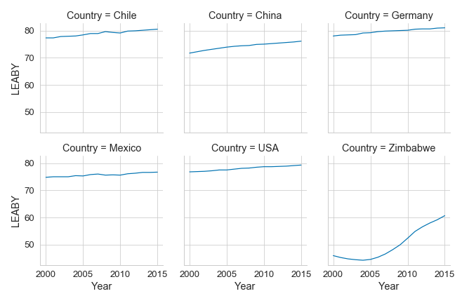
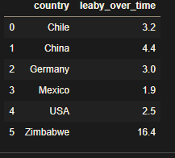
2.5 Mapping Life Expectancy by country
In this step, we will compare life expectancy for each country over the years, the line graph would be better illustration for comparing the change in life expectance over the years.
- Which countries' line changes the most?
Zimbabwe,
What years are there the biggest changes in the data?
2000 to 2005 Zimbabwe went through a crisis due to the “land reform”
2005 to 2015 life expectancy increase this correspond with end of internal conflicts
- Which country has had the least change in life expectancy over time?
Mexico experience a growth of two years during this period of 15 years.
Can you think of any reasons that the data looks like this for particular countries?

Slide 14
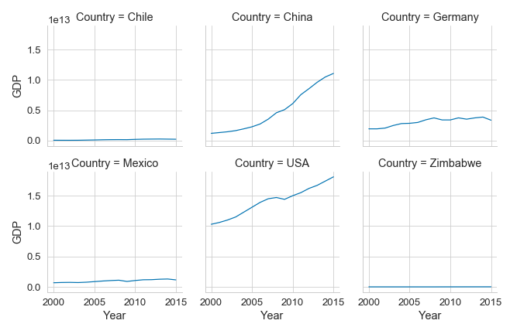
2.6 Mapping GDP by country
In this last step, we will compare GDP for each country over the years, the line graph would be better illustration for comparing the change in GDP over the years.
- Which countries' line changes the most?
China has a tremendous growth in GDP.
-What years are there the biggest changes in the data?
In 2009 there is a drop in GDP for countries like USA, Germany, Mexico and Chile this corresponds with financial crisis
Germany experience drops and falls this could be an indication of technology change
Zimbabwe has a drop in 2008 and then a growth in GDP income due to the local currency inflation and political decision afterwards
-Can you think of any reasons that the data looks like this for particular countries?
Each country from this group comes from different cultural, political and geographic environment, therefore the sum of these features has an impact on GDP and Life Expectance.

Slide 15
3. Insights

Slide 16
3.1 Insights
GDP a good measure of Life expectance?
As we can see there is a positive correlation countries that have a higher GDP and also have a higher Life Expectancy. The logic is when we have more goods and services we are usually can afford more of the other things in life like: time for self development, vacations, health services.
How do you think the histories and the cultural values of each country relate to its GDP and life expectancy?
The country background, political system and cultural values are important characteristics for a nation to flourish economically and improving standard of leaving.
What would have helped make the project data more reliable? What were the limitations of the dataset?
A good illustration of GDP would be a metric that breaks downs a country’s economic output by person and is calculated by dividing GDP of a country by its population, this approach is more realistic to measure standard of leavening but however this measure is far from perfect, GDP per capital it misses the distribution of income.
Which graphs better illustrate different relationships?
Good measure of GDP and Life Expectancy for comparing same country in different points in time is represented in slide 2.3.
Another descriptive measure for comparing the Life expectancy and GDP of different countries is indicated by slide 2.4 and 2.5.

